Slide 1
New Zealand

Slide 2
Rugby
The national sport of New Zealand is rugby.
Boys and girls usually learn to play at school.

Slide 3
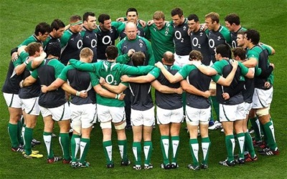
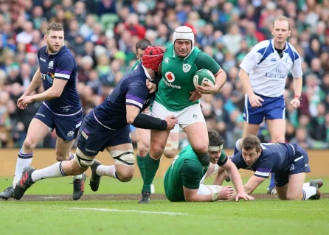
There are 15 players on each team, and the uniform is a rugby shirt, shorts, and long socks. Sometimes people wear a special hat to protect their ears.

Slide 4
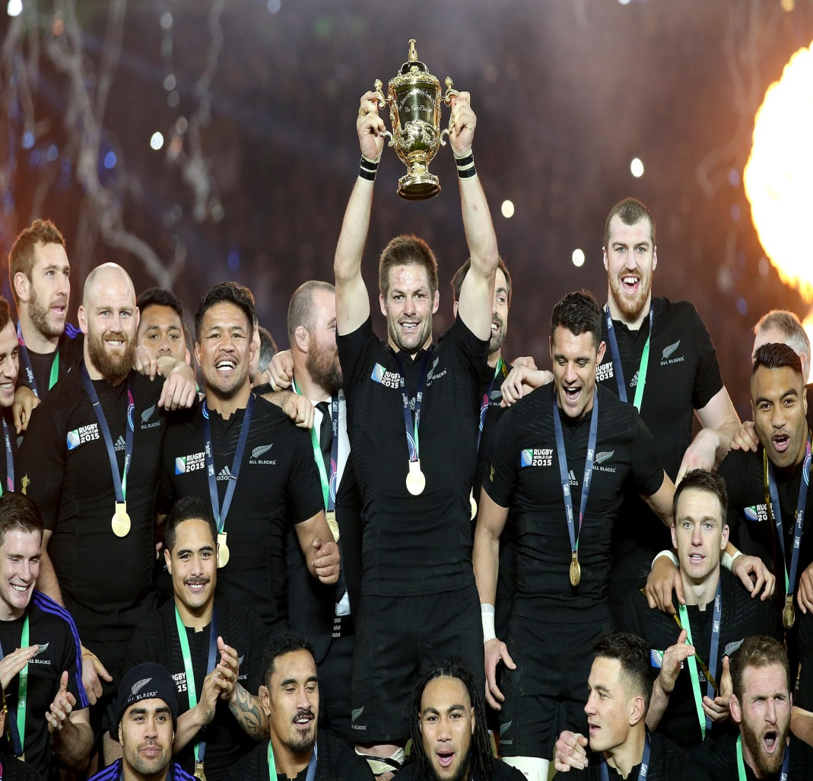
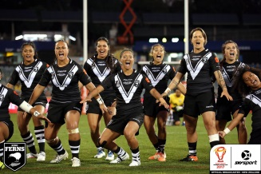
The national team of New Zealand is called the All Blacks and their uniform is …
all black!

Slide 5
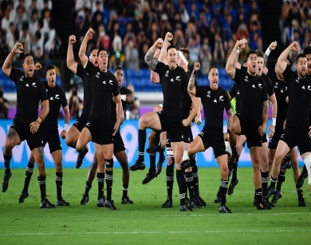
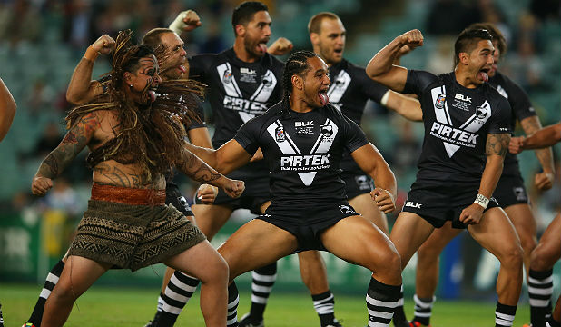
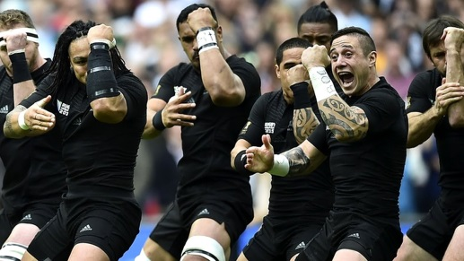
At the start of every game there is a very interesting tradition— the team performs a traditional Maori dance called the Haka.

Slide 6
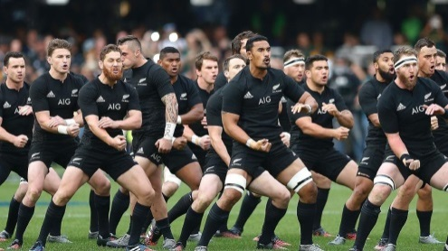
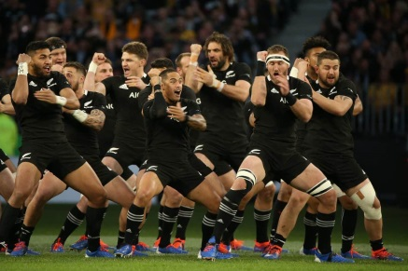
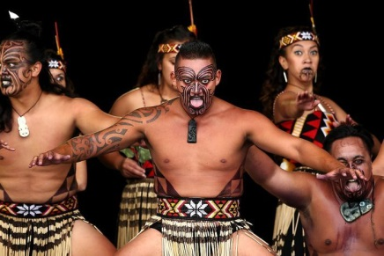
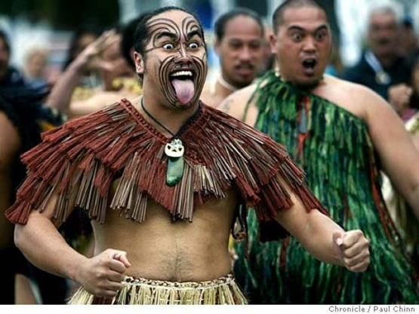
The players dance and shout at the same time. It’s very exciting!

Slide 7
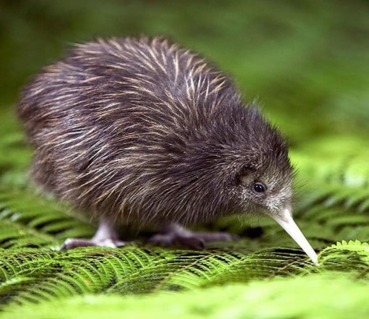
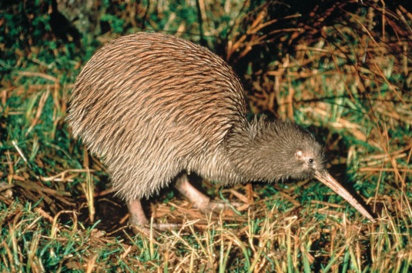
New Zealand has two national symbols,
a bird called a kiwi, and a silver fern leaf.

